Slide 1




Behind the Beats:
The Untold Stories Behind
2023's Hottest Spotify Hits
Midterm Project II
Vanessa Lattas, Michele Maslowski, Violet Wang
Notes:
VW

Slide 2




Problem Statement
$14.69 billion in revenue in 2023 (Iqbal 2023)
12.9% increase year-on-year (Iqbal 2023)
626 million monthly active users (Singh 2024)
Our goal is to identify what song attributes contribute to song’s success on Spotify in terms of number of streams.
Can we accurately predict whether songs will be high-streaming or low-streaming?
Notes:
VW

Slide 3

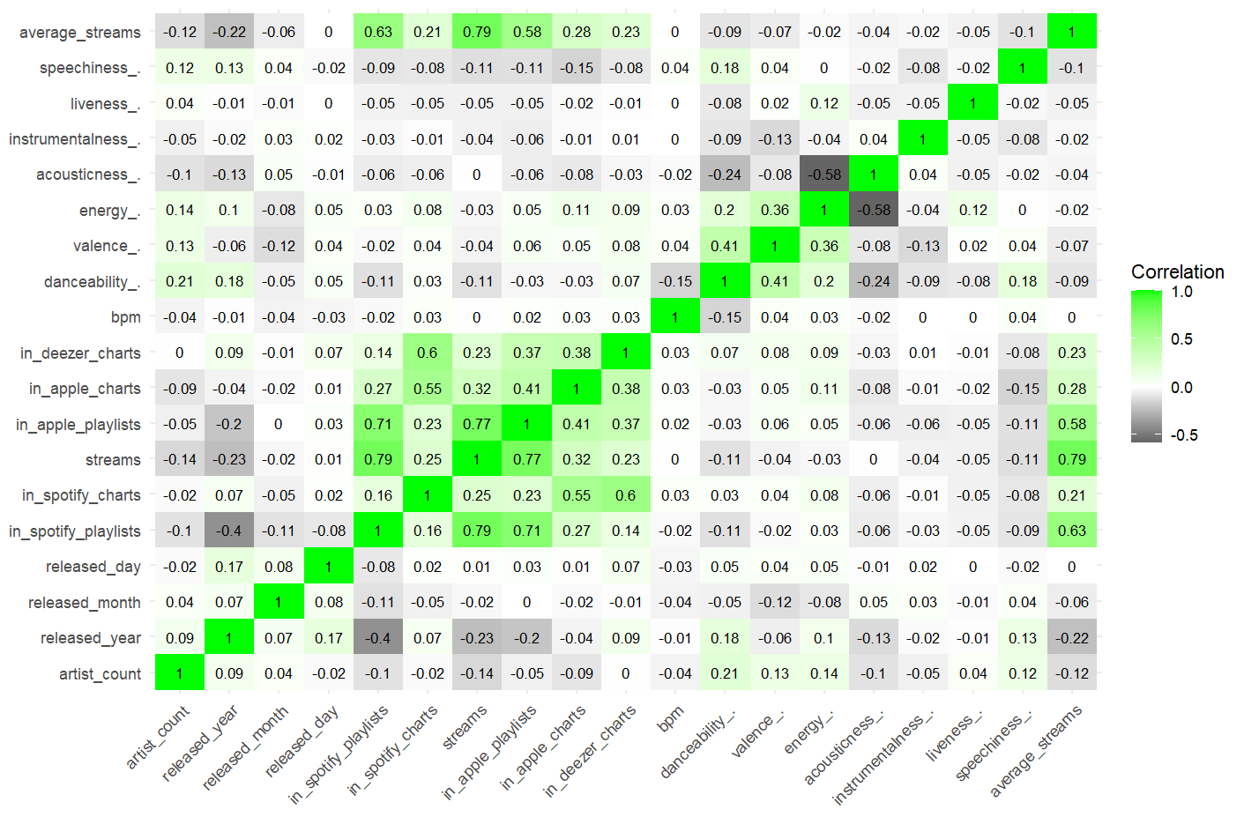
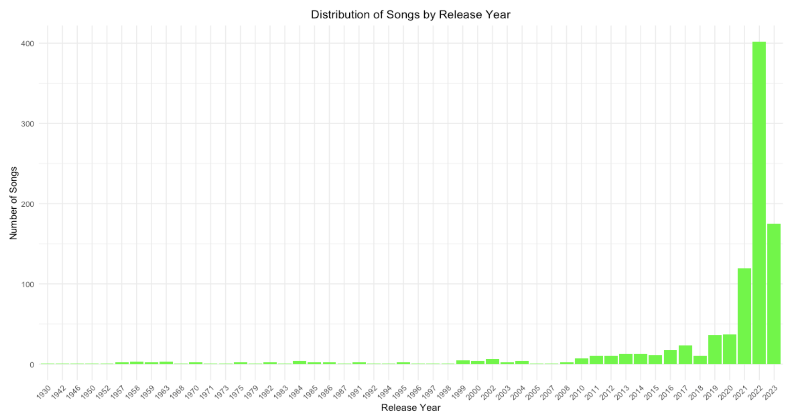


Exploring The Data
Feature Correlation Heatmap
Song Distribution by Year Bar Chart
Top Streamed Song: Blinding Lights by the Weeknd
Majority of songs released in 2022 and 2023
Notes:
MM
First, we explored the data. The heatmap shows the pairwise correlations between every feature. We wanted to check for extreme multicollinearity. The features range from playlist adds, chart position, to energy and BPM in the song. One thing to keep in mind is not every song is from 2023. The data set contained the top streamed songs in 2023. The majority of the songs are from 2022 and 2023 but some are older. The top streamed song was blinding lights by the weekend.

Slide 4
Data Preprocessing
01
Converted values to numeric
02
Created Binary Output Column
Output Column:
Mean # of Streams: 514,137,424
Above = 1
Below = 0
Features Removed:
Key
Artist Name
Track Name
In deezer playlist
Shazam charts
Mode
03
Located Missing Values
Examples of Features Included:
bpm
in_spotify_charts
in_apple_charts
artist_count
release date
energy
04
Finalized 17 different Features
05
Test/ Train Split (80/20)
Notes:
MM
We then pre-processed the data. The first thing we did was converted the values to a numeric data type. Next, our goal is to predict streams but that values is not categorical. We then used the mean # of streams which was 514 million as a threshold. Values were deemed high stream a 1 if above or lower streams a 0. Next, we then located missing values in the data set. We then removed the feature columsn if they had too many missing values. We also removed track and artist name. We ended up with 17 features.
Finally, we defined an 80/20 test/train split that we used for all models.

Slide 5
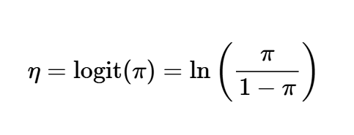
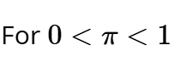
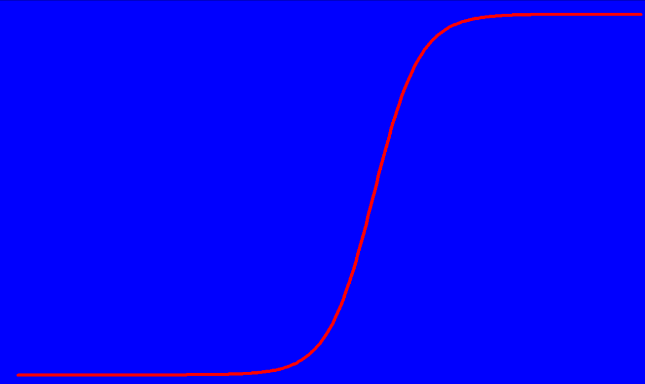

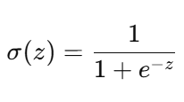
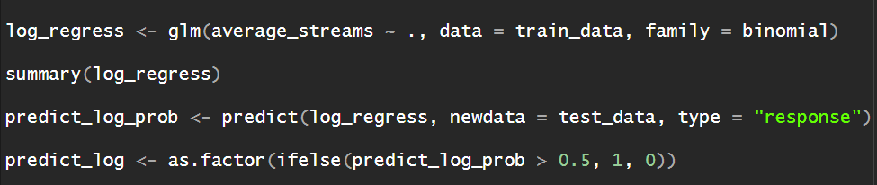
Logistic
Regression
Notes:
MM
The first model we used to predict high and low streams was logistic regression. As we all know logistic regression uses the logit function to create probability values between 0 and 1. The model was implemented in R using the glm function. We used a 0.5 threshold to set predicted values to either 0 or 1.

Slide 6


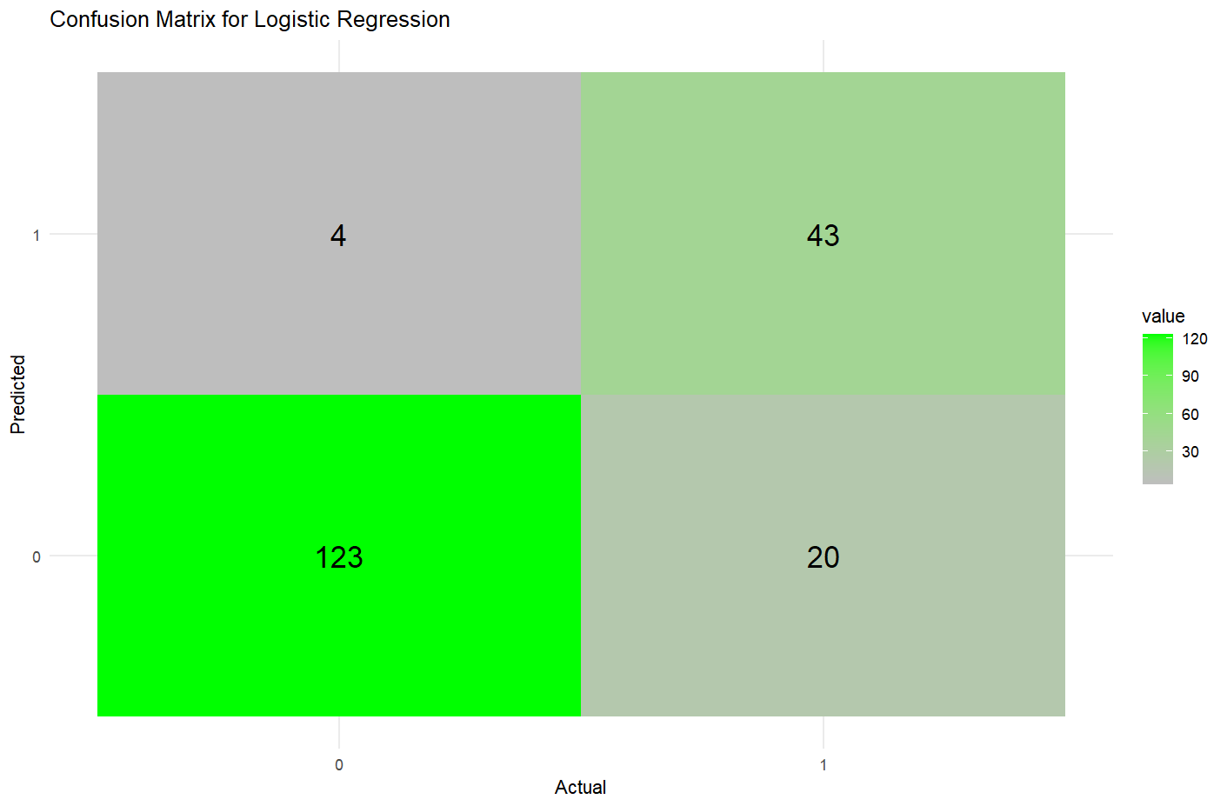
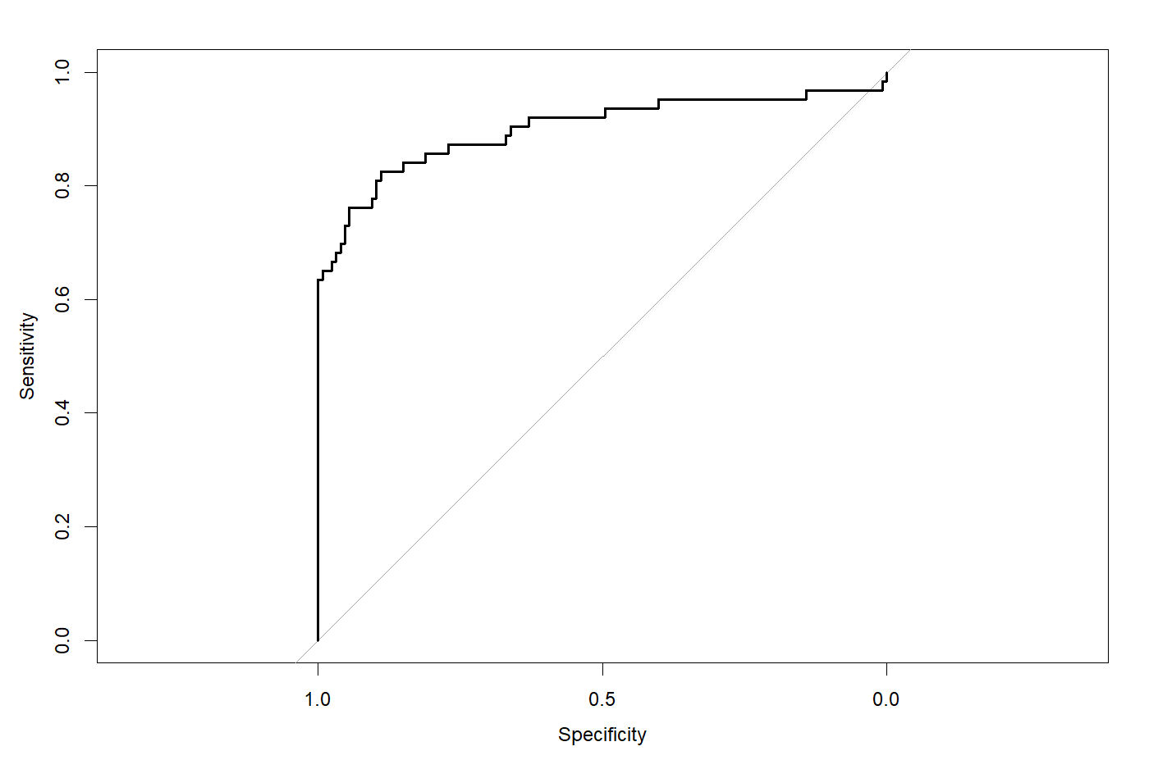
Logistic Regression
87.37%
0.9004
Accuracy
AUC
Notes:
MM
The logistic regression results: the accuracy was 87.37% and the AUC was 0.9004 which mean our model was performing better than chance. The ROC curve is also show. Looking specifically at the confusion matrix we see that the model performed best at identifying entries with low streaming values but struggled to identified the higher streaming values.

Slide 7
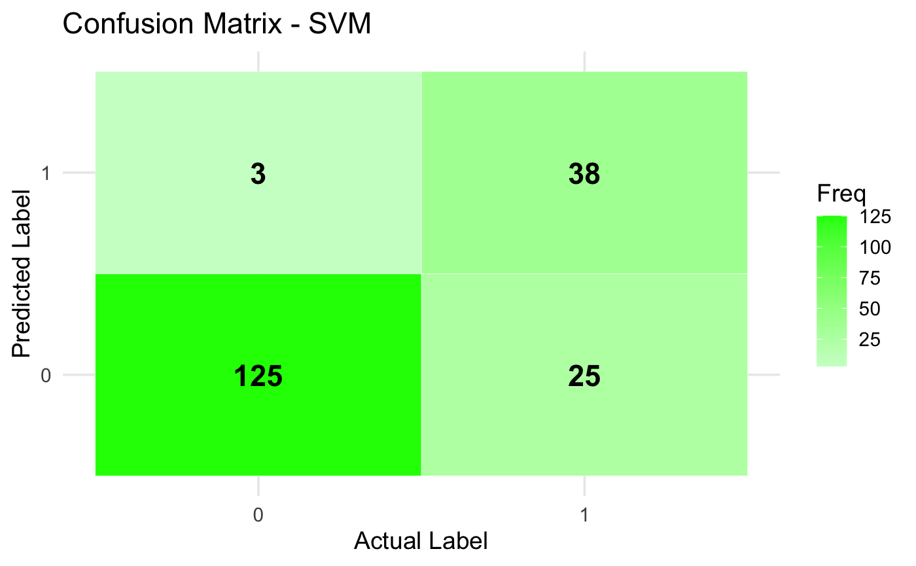
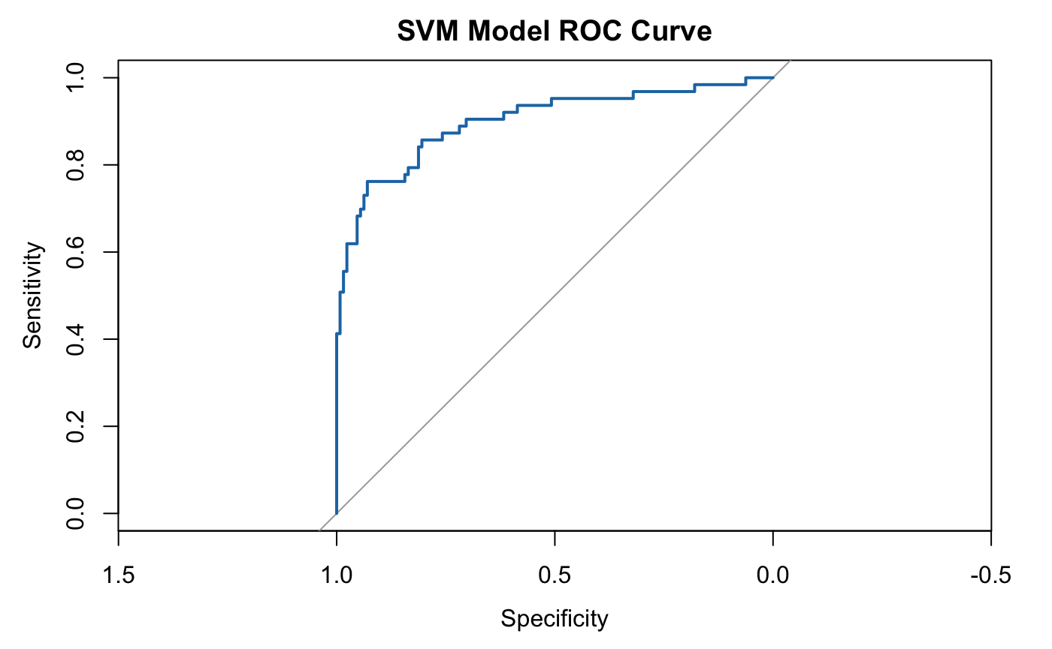
SVM
85.34%
0.8997
Accuracy
AUC
kernel = "radial"
Notes:
Support Vector Machines find the optimal boundary (hyperplane) to separate classes by maximizing the margin between them in a feature space, defined by a kernel function. We defined our kernel to be RBF since it is the most flexible.
We scaled or normalized the input features first to ensure equal feature contribution, particularly because SVM is a distance-based model. So if one feature has a much larger scale than others, it will dominate the distance calculation, making the model biased toward that feature. So scaling helped us troubleshoot that.
To attempt to handle the class imbalance in our data, we used a weighted SVM, which assigns different weights to the 2 classes based on their frequency. This slightly improved the performance for the minority class (top streaming songs) and our overall prediction accuracy.
There still seems to be a lot of false negatives in our confusion matrix for this model.

Slide 8
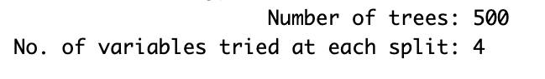
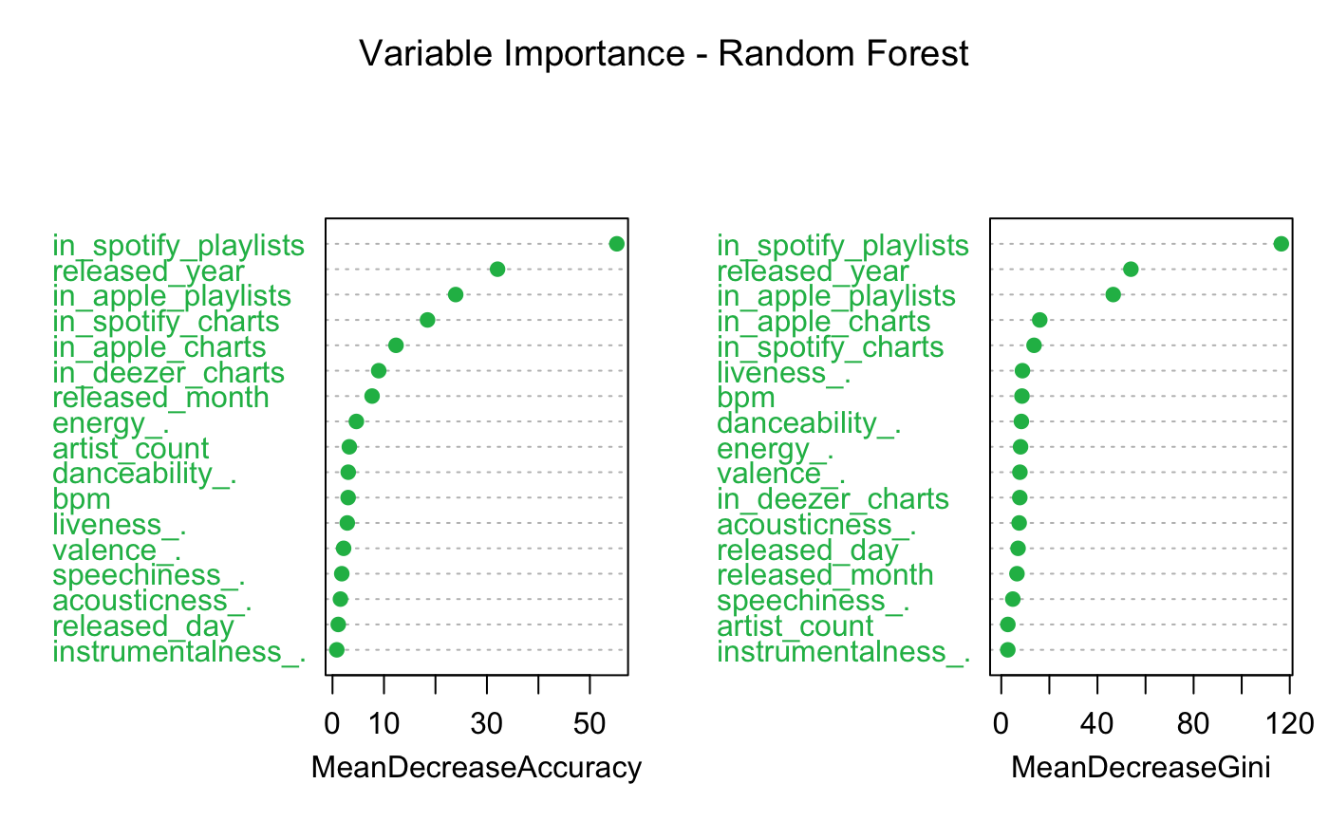
Random
Forest
The higher the value of Mean Decrease Accuracy or Mean Decrease Gini score, the more important the variable is to the model for making accurate predictions.
Notes:
4 features considered at a time for making splits. 500 decision trees. Variable Importance tells us which features are most influential in predicting the target variable (streams).
Higher on the left plot means that excluding that feature makes the model significantly worse. Higher on the right plot means that that feature helps split the data better (or rather increases the homogeneity of the classes). Both plots show that playlist/chart presence and release year are most important. But features like instrumentalness and artist count are less important.

Slide 9
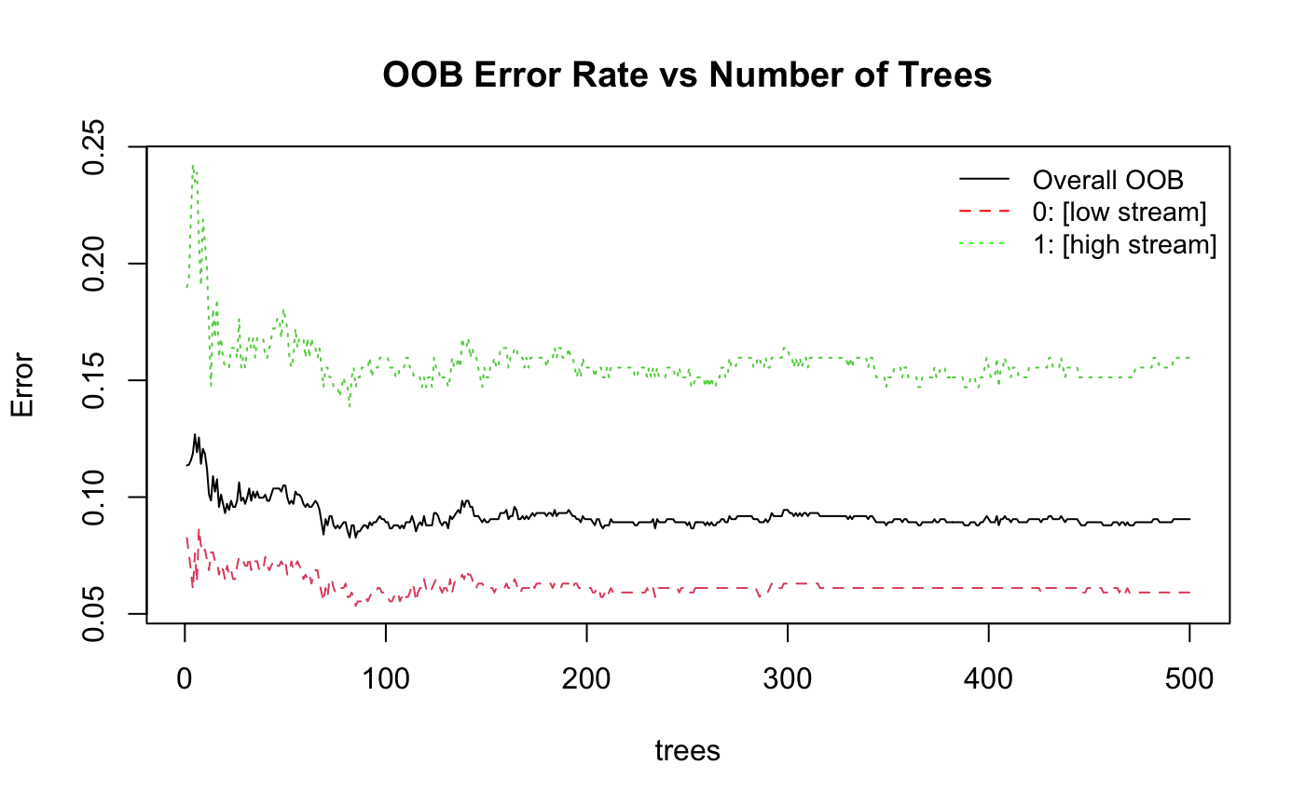
Random
Forest
OOB overall prediction error rate (on training data): 7.62%
.
Notes:
For tree-based models, it is important to compute the OOB error rate, shown in this plot, in addition to the predictive accuracy. Each decision tree in the model is trained on a random subset of the training data, leaving some samples out (OOB). So we use the trees that didn’t see a certain data point to make predictions, then compare these predictions to the true label. The OOB error is the average error for these left-out training samples.

Slide 10
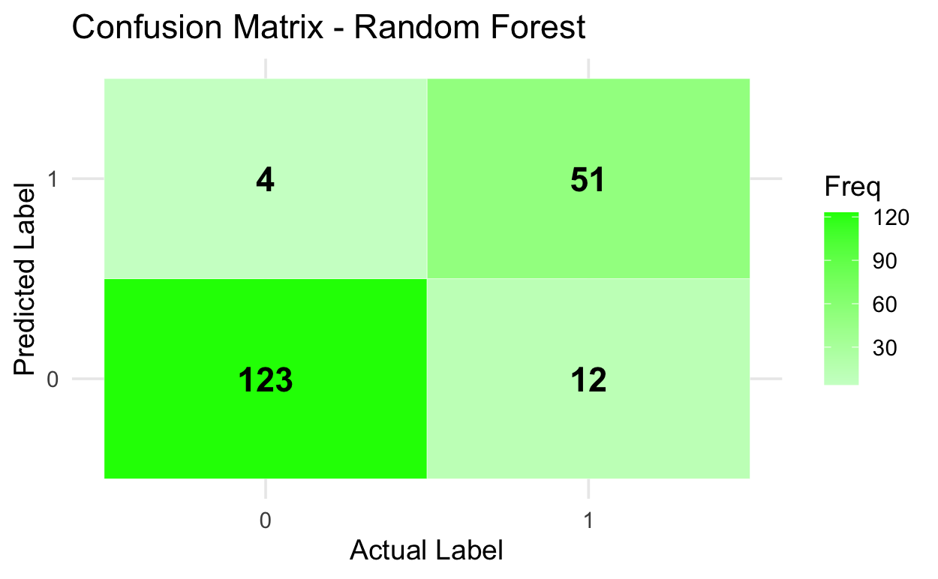
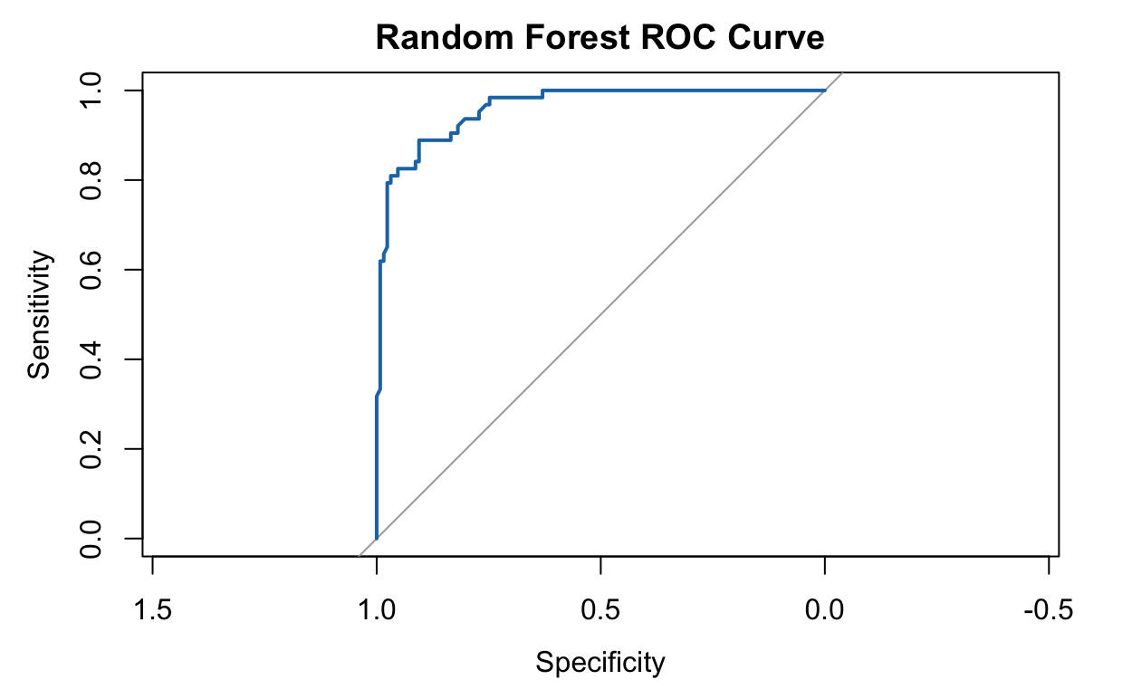
Random
Forest
91.58%
0.9609
Accuracy
AUC
Notes:
Random forest model has the highest predictive accuracy at 91.58%. Lowest amount of false negatives and false positives.

Slide 11
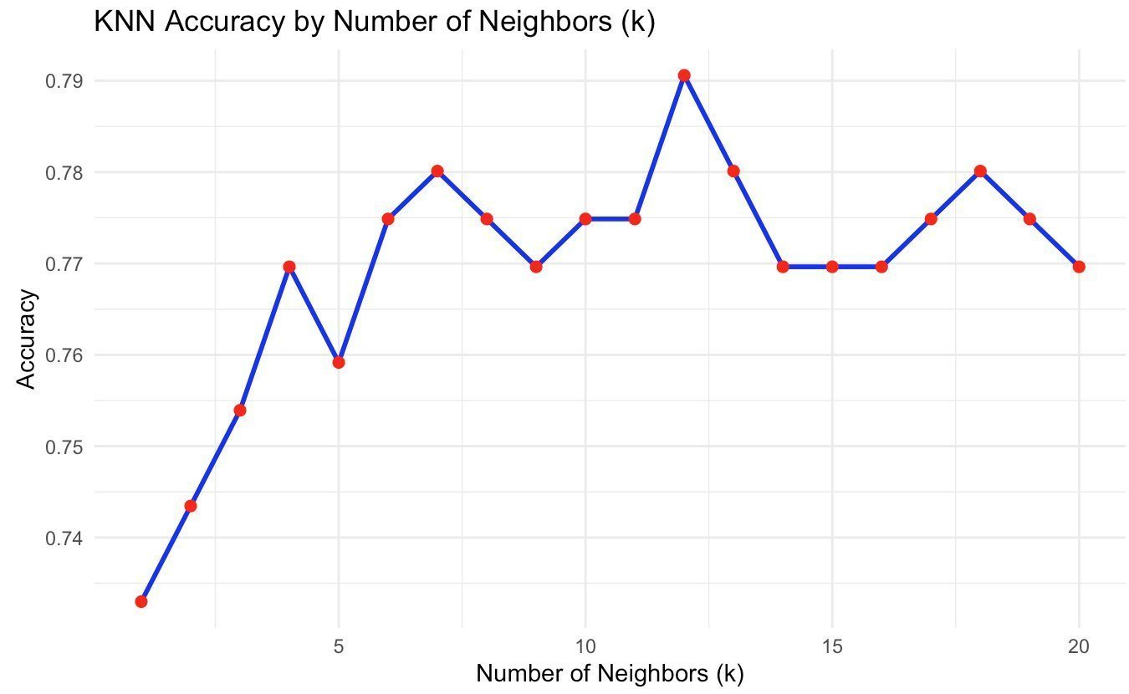
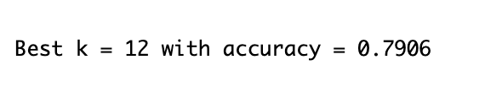
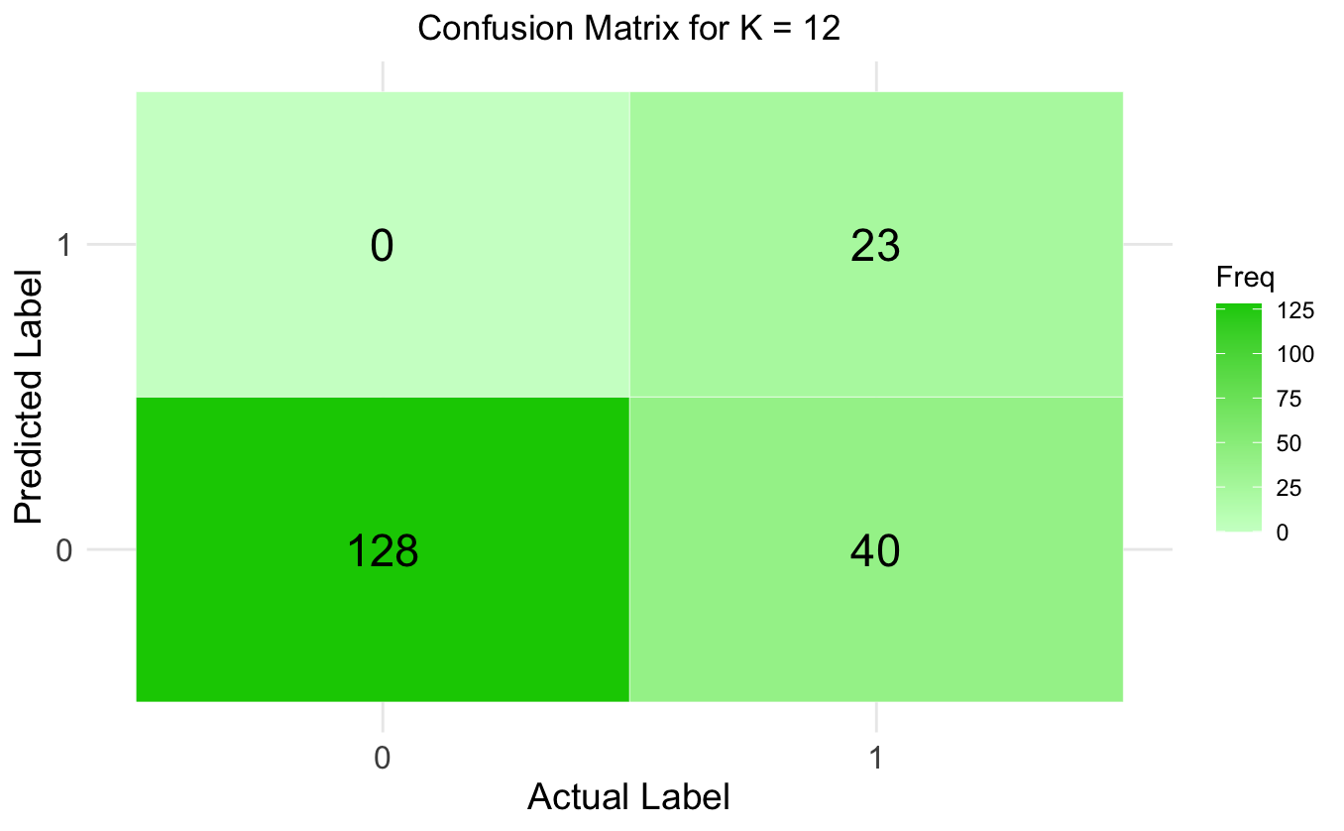
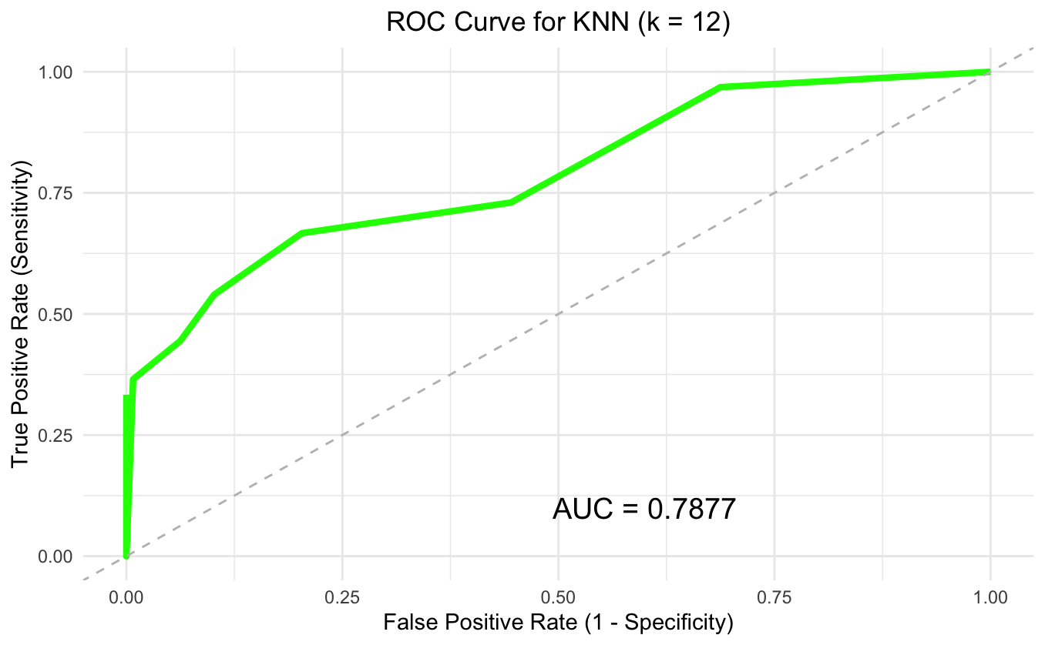
KNN
79.06%
0.7877
Accuracy
AUC
Notes:
VW: K-Nearest Neighbors works by predicting a song’s class based on the majority class among its closest neighbors. In our case, we used different features to classify whether a song would have above-average streams or below-average streams.
The best performance is when k = 12, with an overall accuracy of 79.06% and an AUC of 0.7877. But when we look deeper, accuracy doesn’t tell the whole story. The confusion matrix shows that the model correctly predicted 128 songs with below-average streams, which is the majority class. However, it misclassified 40 songs that actually had above-average streams, and only got 23 hits right. This means the model is heavily biased toward the majority class. It struggles to correctly identify hits, which are the smaller portion of the dataset.
So while the accuracy seems decent, KNN underperformed in identifying hits, making it the most affected model by class imbalance in our project.

Slide 12

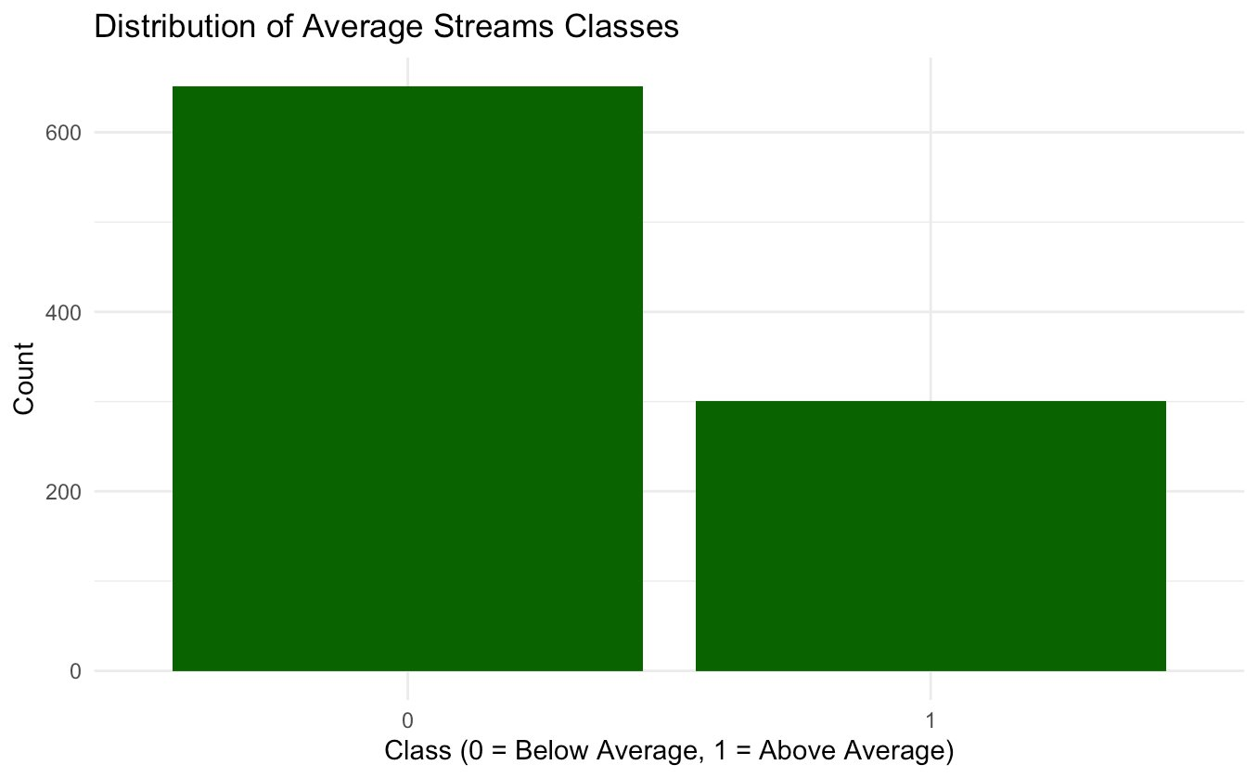

Model Comparison
Model | Accuracy | Precision | Sensitivity (0) | Specificity (1)
Random Forest | 91.58% | 0.9111 | 0.9685 | 0.8095
Logistic Regression | 87.37% | 0.8601 | 0.9685 | 0.6825
Support Vector Machine (SVM) | 85.34% | 0.9268 | 0.6032 | 0.9766
k-Nearest Neighbors (kNN) | 79.06% | 0.7515 | 0.9922 | 0.3333
0 | 1
651 | 301
Significant class imbalance which could affect accuracy of prediction
Notes:
VW: Due to class imbalance, we tried to add class weight to the training set but the result didn't change much.
Among all models, Random Forest performed the best and was the least impacted by class imbalance, due to its ability to handle complex data and balance the classes internally. Logistic Regression and SVM did reasonably well but showed signs of bias toward the majority class. kNN struggled the most due to its reliance on local neighbors — which were mostly from the majority class.

Slide 13
Limitations + Future Directions
Class Imbalance
Hyperparameter Tuning
Limited Number of Features
Lyrical Analysis, Genre Classification
Notes:
●SVM hyperparameters include cost and gamma, could be tuned better to improve accuracy
●Other features that could be important: length of the song, genre of the song, virality, explicit lyrics

Slide 14
1. Iqbal, Mansoor. "Spotify Revenue and Usage Statistics (2024)." Updated October 1, 2024. Business of Apps. 2. Singh, Shubham. "Spotify Statistics (2024) – User Growth, Top Artists & More." September 17, 2024. Demand Sage.
3.https://www.kaggle.com/datasets/nelgiriyewithana/top-spotify-songs-2023

Slide 15
Thank you for listening!
Questions?

